Slide 1

Project Presentation
Title:
Emotion-Based Music Classification and Recommendation System.
Leveraging Emotional Features for Better Music Recommendation.
By
Ibediogwu Promise Ekele
August 2024

Slide 2
Methodology: Case Study - Moodify Song Classification
Phases Involve:
Introduction: Understanding Business Problem
Analytic Approach
Data Requirement and Data Collection
Data Understanding
Exploratory Data Analysis
Data Cleaning and Data and Preprocessing.
Modelling and Evaluation
Deployment/Implementation
Conclusion/Recommendation

Slide 3
Understanding Business Problem
This is a Problem of Moodify Company trying to classify and predict the choice of song selection from their audience based on their lyrical, musical, and emotional features, to provide users with more successful recommendation outputs.
Goal/Aim
Moodify goal and aims to categorize songs into four main emotions and utilize the similarities in musical features within these categories to offer users more effective recommendations, weighting them with emotions.
Objective
Develop a Classification Model to help classify songs based on the given features and the given dataset.
Improve the accuracy of model by understanding the features and emotional impact of the song’s.

Slide 4
Analytic Approach
The stated problem can be solved using various Machine Learning classifiers because it is a Classification Problem.
The various Machine Learning algorithms will be used, evaluated, and cross-validate to know the best based on their different accuracy values or scores.
The features will be examined to determine which is the one that has the greatest effect on the Song Classification.
Machine Learning Classifiers such as:
Decision Tree
Logistic Regression
GaussianNb
Random Forest
K-Nearest Neighbor
Xgboost Classifier
LightGboost

Slide 5
Data Requirement and Data Collection
The required data for this problem is the dataset that contains the song metadata i.e. the emotional and lyrical features.
The Dataset should contain vital information about the song category. To solve this problem, data about various features that make up the categories of a song should be collected to know the proper label to be classified.
The Dataset that will be used in this Problem is the ‘Moodify’ Dataset from Spotify. Source: https://www.kaggle.com/datasets/abdullahorzan/moodify-dataset.
The Dataset consists of two types:
278k_labelled_uri.csv: contains the url link to the song.
278k_song_labelled.csv: does not contains the url link to the song.

Slide 6
Data Understanding
Data Description:
From the provided data set i.e ‘278k_labelled_uri.csv’ and ‘278k_song_labelled.csv’ data set we shall be using jus he ‘278k_song_labelled.csv’ which does not contain the link to the song.
The dataset contains the dependent and the independent features:
Dependent: labels (4 types of songs)
Independent: Duration (ms), Danceability, Energy, Loudness, Speechiness, Acousticness, Instrumentalness, Liveness, Valence, Tempo, Spec_rate.
In total, the dataset contains 278,000 songs categorized into 4 labels from spotify, with 11 different independent features.

Slide 7
Data Understanding (con’t)
More information about the dataset.
Independent features:
Acousticness: A confidence measure from 0.0 to 1.0 of whether the track is acoustic. 1.0 represents high confidence the track is acoustic.
Danceability: Danceability describes how suitable a track is for dancing based on a combination of musical elements including tempo, rhythm stability, beat strength, and overall regularity. A value of 0.0 is least danceable and 1.0 is most danceable.
Energy: Energy is a measure from 0.0 to 1.0 and represents a perceptual measure of intensity and activity.
Instrumentalness: Predicts whether a track contains no vocals measures from 0.0 to 1.0
Liveness: Detects the presence of an audience in the recording. Higher liveness values represent an increased probability that the track was performed live. Measures from 0.0 to 1.0
Loudness: the overall loudness of a track in decibels (dB). Values typically range between -60 and 0 db.

Slide 8
Data Understanding (con’t)
Speechiness: Speechiness detects the presence of spoken words in a track. The more exclusively speech-like the recording (e.g. talk show, audiobook, poetry), the closer to 1.0 the attribute value. Values above 0.66 describe tracks that are probably made entirely of spoken words. Values between 0.33 and 0.66 describe tracks that may contain both music and speech.
Valence: A measure from 0.0 to 1.0 describing the musical positiveness conveyed by a track. Tracks with high valence sound more positive (e.g. happy, cheerful, euphoric), while tracks with low valence sound more negative (e.g. sad, depressed, angry).
Tempo: The overall estimated tempo of a track in beats per minute (BPM). In musical terminology, the tempo is the speed or pace of a given piece and derives directly from the average beat duration.
Duration (ms): his features shows he duration of he song, measured in microseconds
Dependent feature:
This is the label feature which depend largely on he independent features, this feature tells of the type of song.
Comprise of 4 categories:
Labels: {'sad': 0, 'happy': 1, 'energetic': 2, 'calm': 3}

Slide 9
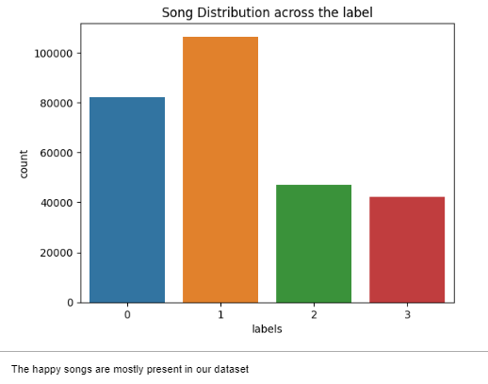
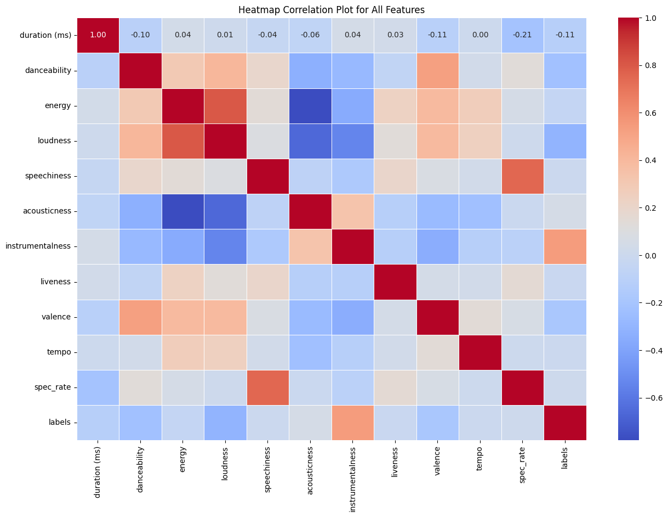
Exploratory Data Analysis
Data Visualization:
Distribution of song across he label using barplot Correlation char showing relaionsip beween features

Slide 10
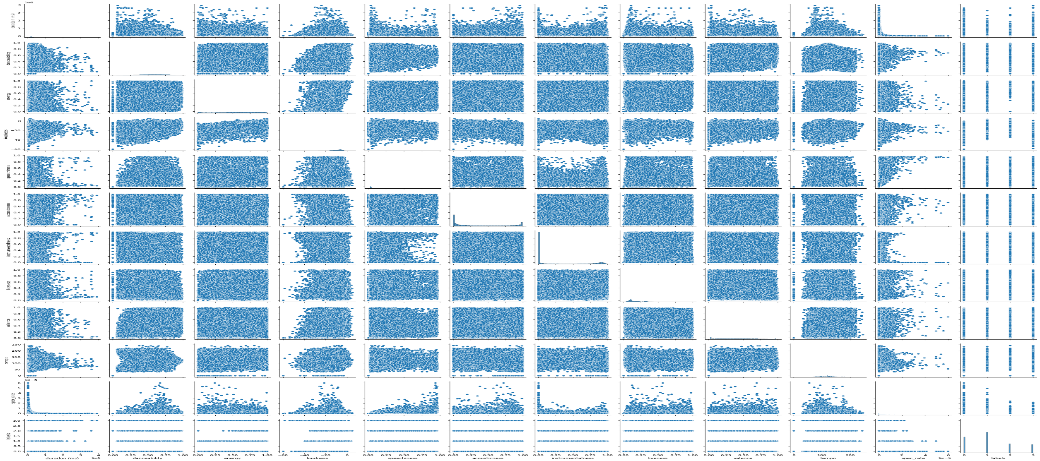
Exploratory Data Analysis (con’t)
Pairplot showing he relationship among features

Slide 11
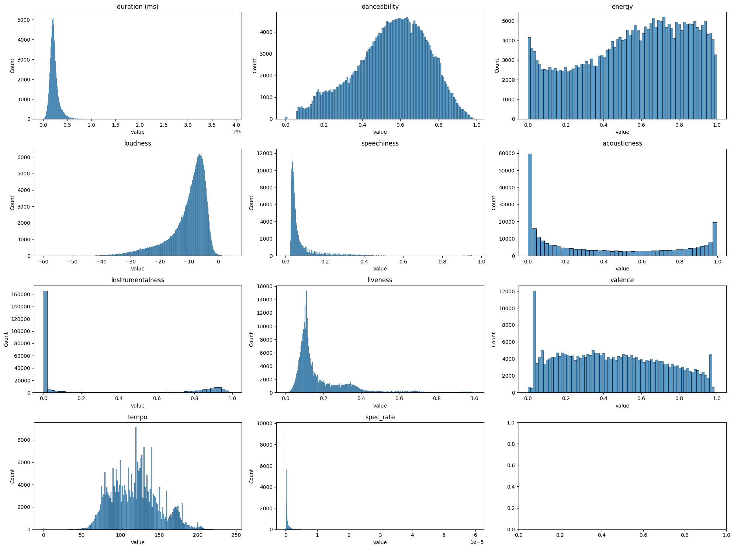
Exploratory Data Analysis (con’t)
Understanding the distribution of the numerical features

Slide 12
Exploratory Data Analysis (con’t)
Insight from the Analysis
The dataset contain more of the Happy label songs
Sad songs have low danceability, low energy, moderate tempo and low duration
Energetic song has moderate danceable, high energy, and low duration and high tempo
Most of the calm songs have high energy, high danceability, high duration and moderate tempo.
There is a correlation between the energy and loudness, possibility high
Duration has little or no correlation with other features.
The dataset also contain outliers.

Slide 13
Data Cleaning and Data and Preprocessing.
Data Cleaning:
During the data cleaning process the following was done .
A column name unnamed was made he index id of the dataset, because it contains an ordered arrangement of all the records in the dataset.
We checked for missing values if there are any, but there were no missing values, using the df.info() function.
We also checked if there were an duplicates, using the function, df.duplicated().sum(), but ther were no duplicate in the dataset

Slide 14
Data Cleaning and Preprocessing. (con’t)
Data Preprocessing:
Scaling of the Dataset
During this phase, the dataset was preprocess by using Roburst scaler to scale the dataset because of the presence of ouliers in order to help the model perform better.
Feature Engineering
During the feature engineering phase of data preprocessing, new features were created so as to improve the performance of the model.

Slide 15
Data Cleaning and Preprocessing. (con’t)
Feature Engineering (con’t)
The following features were created:
Energy + Tempo (ET): for overall intensity
Valence + Danceability (VD): for emotional expression and mood of the song
Instrumentalness * Accousticness (IA): the style of the song
Danceability*0.1 + Instrumentalness*0.2: Captures the presence of instrument and if the song is danceable to what degree.
(Energy + Tempo +Valence)/3: The average of the features
Add all the features used above: To capture the presence of all he features in their respective scale.

Slide 16
Modelling and Evaluation
Modelling:
The dataset was splitted into train set (80%) and test set (20%) using train_test_split sklearn.model_selection library.
The Train set was fittied into he following Machine Learning classifiers:
Decision Tree
Logistic Regression
GaussianNB
Random Forest
K-Nearest Neighbor
Xgboost Classifier
LightGBM

Slide 17
Modelling and Evaluation (con’t)
Evaluation:
After Building the model classifiers, the test set is then used to evaluate the score of the Model to obtain the best model out of all the models used.
Machine Learning models can be evaluated using different evaluation techniques.
The model can be evaluated using the Accuracy score or Confusion Matrix:
The model with the optimal accuracy score, type 1 and type 2 Error, optimal F1- accuracy score is the best model.
Note: Evaluation metrics are used based on the nature of the given dataset.

Slide 18
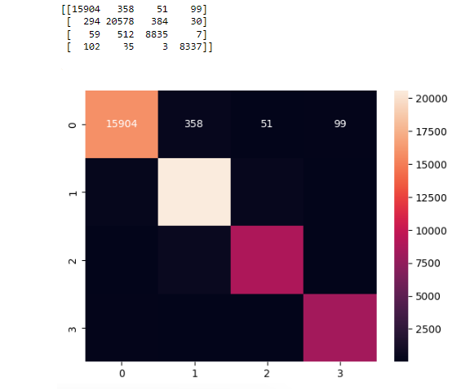
Modelling and Evaluation (con’t)
Result The following model gave an optimal f1-score accuracy of above 80% and an optimal True positive values from the confusion matrix, the XGBoost (0.97) proved to be the best compare to others:
1. Decision Tree classifier ---------- (0.90)
2. Random Forest -------------------- (0.94)
3. Catboost ---------------------------- (0.96)
4. XGBoost --------------------------- (0.97)
5. LightGBM ------------------------- (0.96)
6. AdaBoostClassifier --------------- (0.80)
Confusion Matrix

Slide 19
Modelling and Evaluation (con’t)
Cross validation: This is a process whereby the model is beings test with various fold or portion of the test dataset to validate is accuracy.
Our various classifiers where cross validated using the cross_validate function sklearn.model, the test set was splitted into 5 folds. Below are the mean accuracy for all the classifiers:
1. Decision Tree classifier ------------------- 0.897
2. Random Forest ----------------------------- 0.932
3. Catboost ------------------------------------- 0.959
4. XGBoost ------------------------------------ 0.961
5. LightGBM ---------------------------------- 0.955
6. AdaBoostClassifier ------------------------ 0.823

Slide 20
Deployment/Implementation
After evaluating the model and getting the right model for the problem, the next thing to do is to implement the model in the stated problem to achieve the goal and objective stated.
Pipelining: After cross-validating the model, a pipeline class was created for the Xgboost model, in pipelining, all the processes were fixed together in a file then it can be ready for deployment to make recommendations.

Slide 21
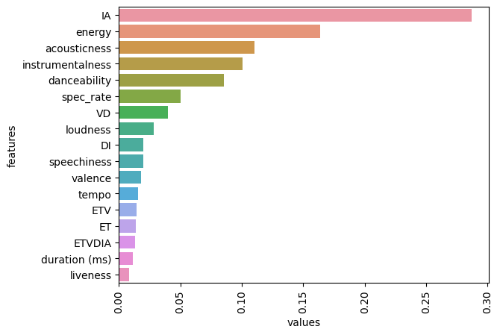
Conclusion.
The goal which is to build a model to categorize songs into four main emotions, which is the Xgboost classifier.
Importance features:
The newly created feature IA which capture the style of the song, using the Instrumental and Acousticness the feature is the important feature followed by energy, acousticness, instrumentalness, danceability, and spec_rate, which proved to be the top six(6) most important feature.

Slide 22
Recommendation
There is room for improvement of the model performance, the model can be fine-tuned, more features can be generated in order to get more optimal accuracy.

Slide 23
Thank You.

